Slide 1
Plant Monitoring System

Slide 2
Motivation

Slide 3
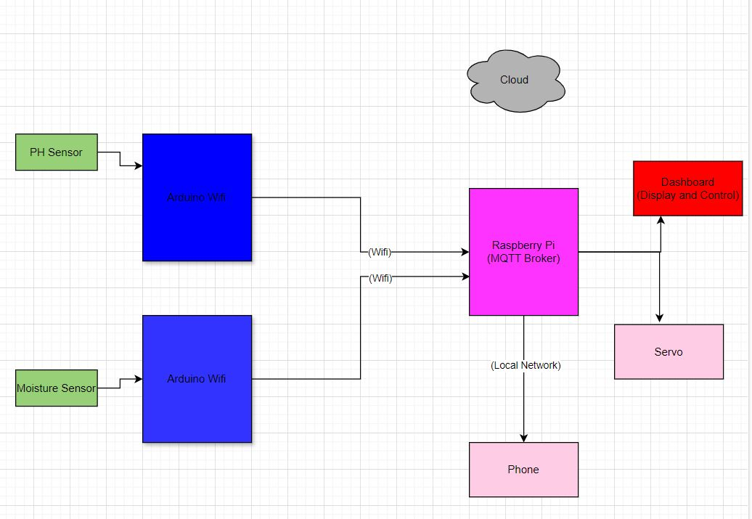
Concept Draft

Slide 4
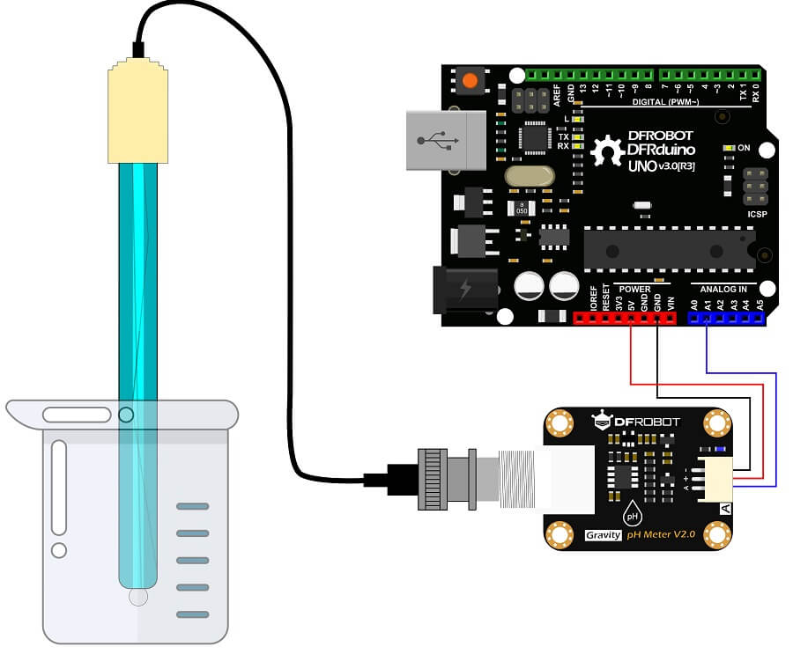
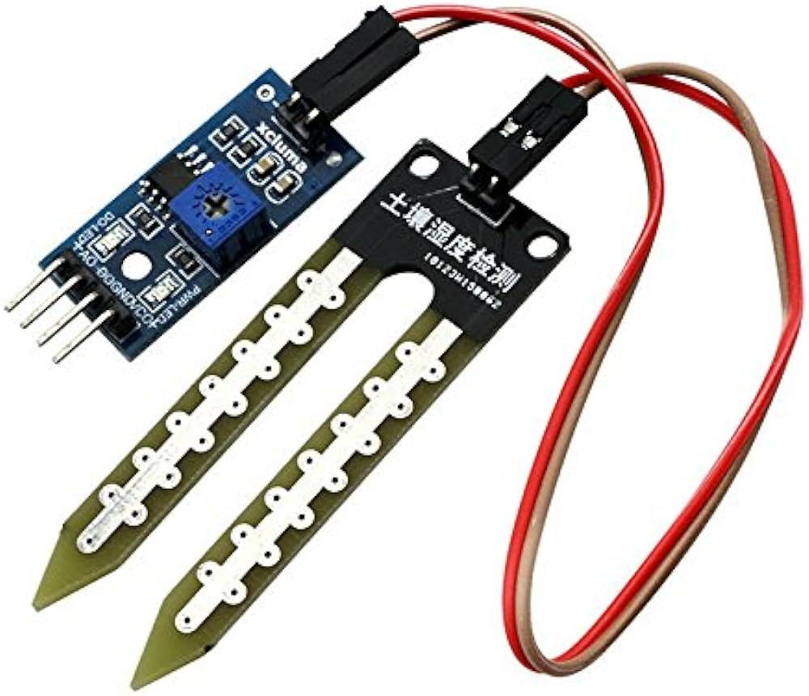
Sensor Nodes Description
Humidity/Moisture Sensor
Mode: Analog to digital(A0 Pin)
Operation: Resistive variation of probes
DFRobot Analog PH Sensor
Mode: Analog to digital (A1 Pin)
Voltage: 3.3v-5.5v
Operation: Voltage variation at various concentration

Slide 5
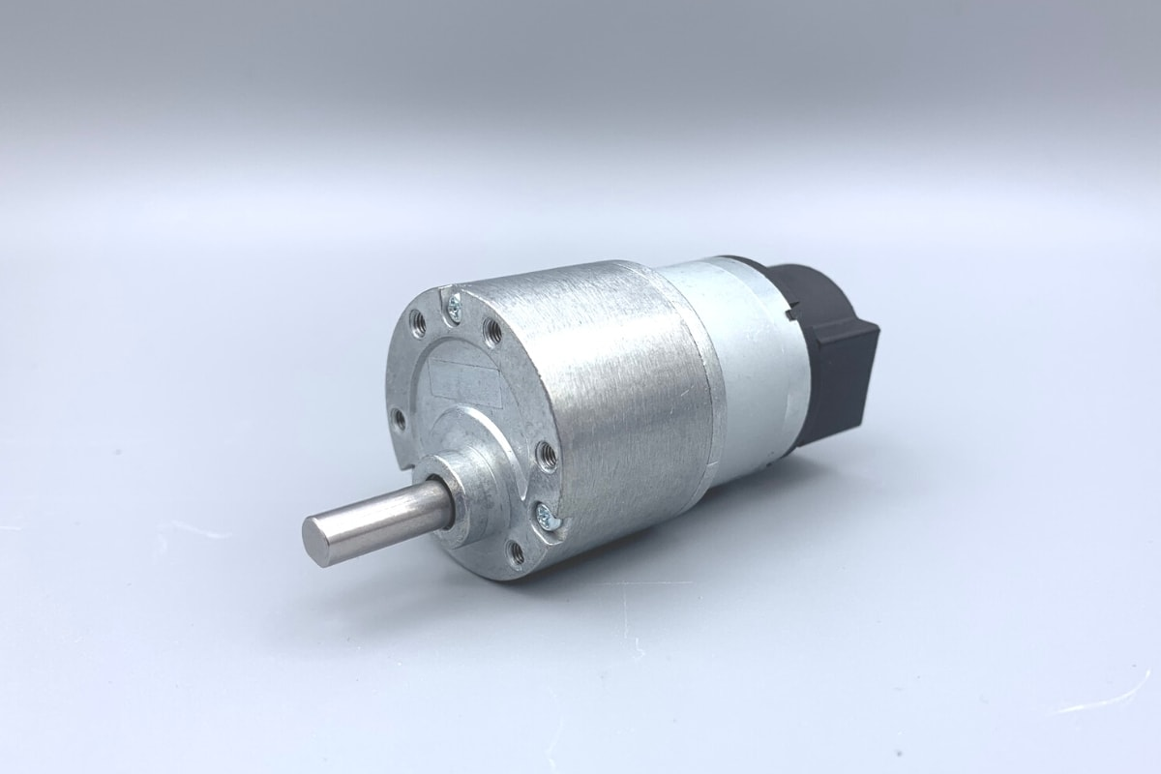
Servo

Slide 6
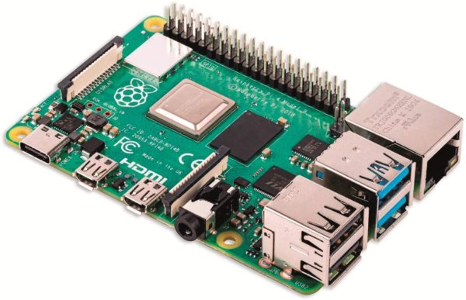
MQTT Broker
Raspberry Pi
MQTT Enablers
Publish and Subscribe Topic (PHTopic and MoistureTopic)
IP Address
Wifi

Slide 7
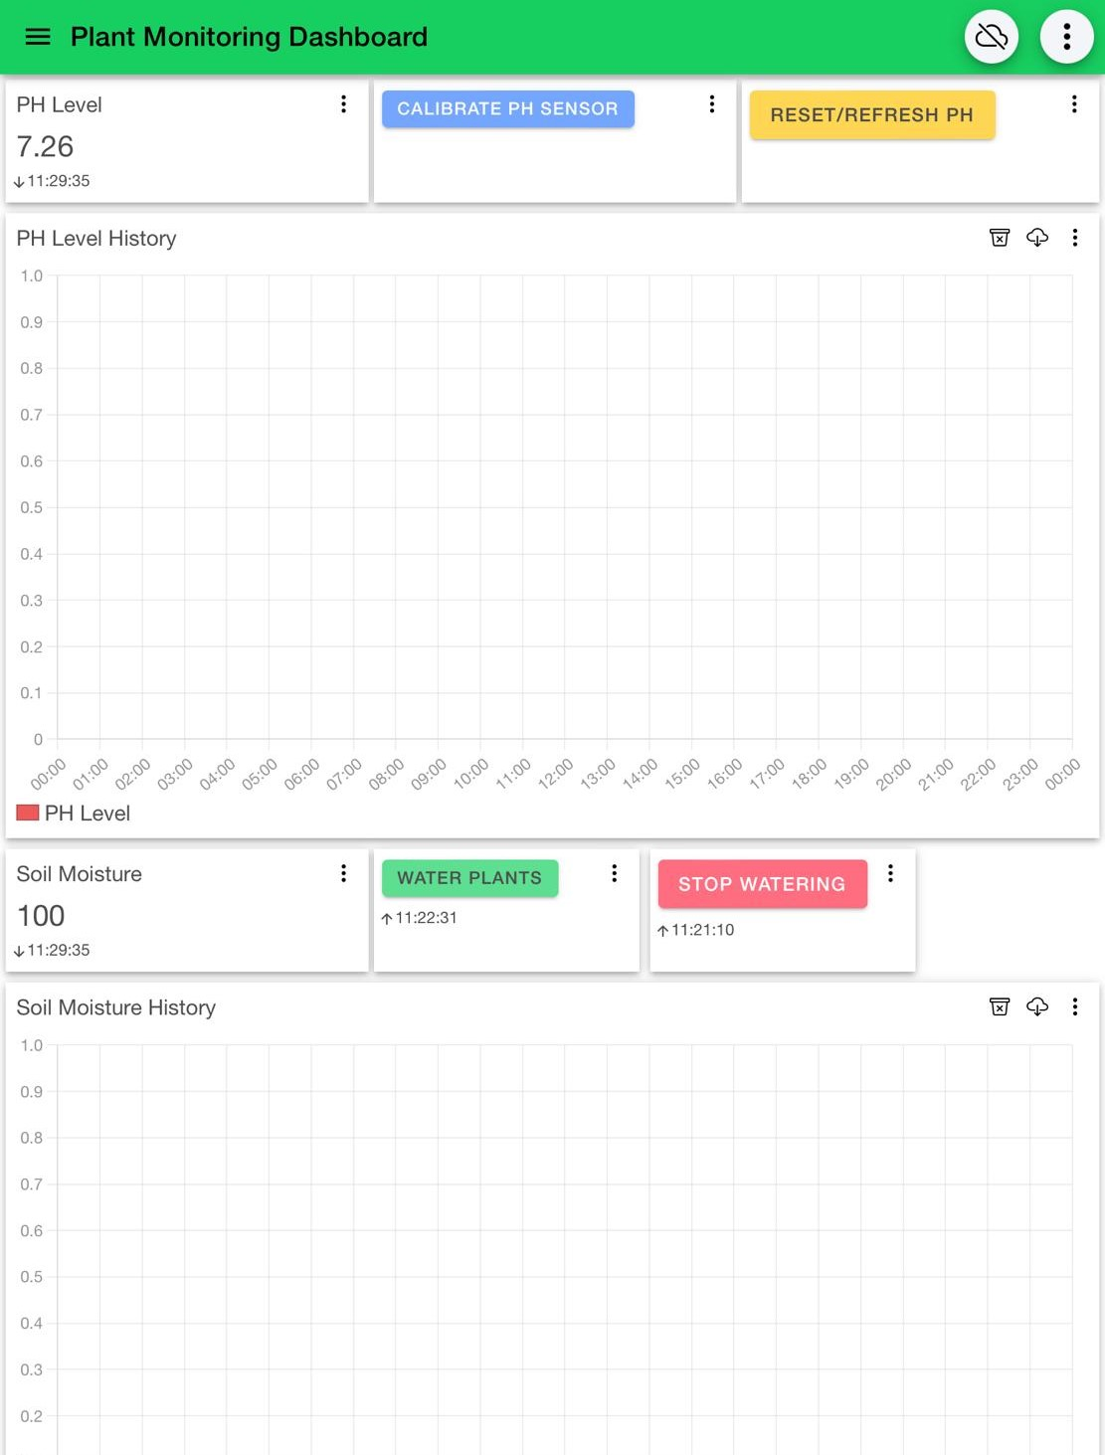
Setting up the Dashboard

Slide 8
Monitoring and Control

Slide 9
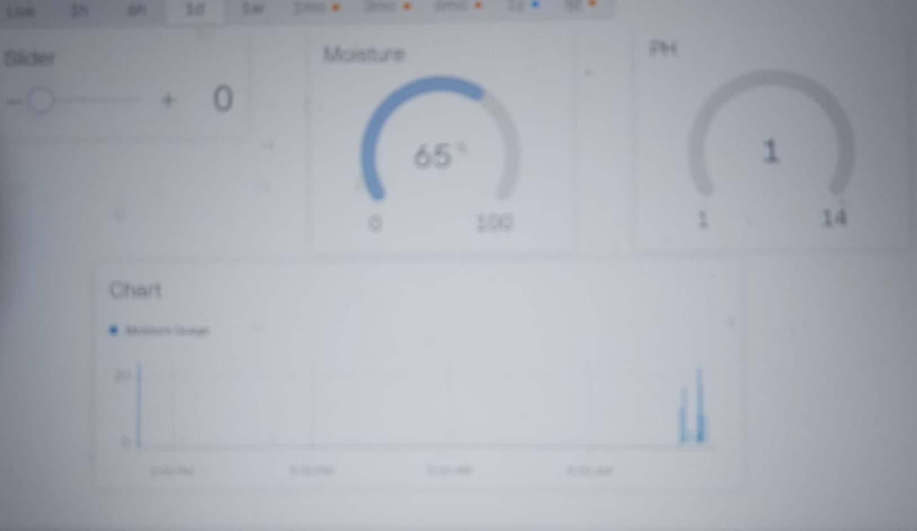
Cloud Services(Blynk)
Notes:
Describe choice of Cloud service, Benefit of Cloud over MQTT dashboard

Slide 10
Conclusion

